Slide 1

Introducing PyCaret
July 16, 2020

Slide 2





About me
Data Analytics Leader by day and passionate Data Scientist by night
Active open-source contributor
Member of CPA, CMA, Canada and ACMA, UK, CGMA
Lived and worked in Asia, Middle East, East Africa, North America
Currently based in Toronto, Canada
https://www.linkedin.com/in/profile-moez/
https://medium.com/@moez_62905/
https://twitter.com/moezpycaretorg1
moez@pycaret.org

Slide 3
Important Links
Official : https://www.pycaret.org
PyCaret GitHub : https://www.github.com/pycaret/pycaret
LinkedIn : https://www.linkedin.com/company/pycaret
YouTube : https://www.youtube.com/channel/UCxA1YTYJ9BEeo50lxyI_B3g
Medium : https://medium.com/@moez_62905/
Today’s Presentation and Demo : https://www.github.com/pycaret/pycaret-demo-sif
Follow hashtag #pycaret on LinkedIn and Twitter

Slide 4
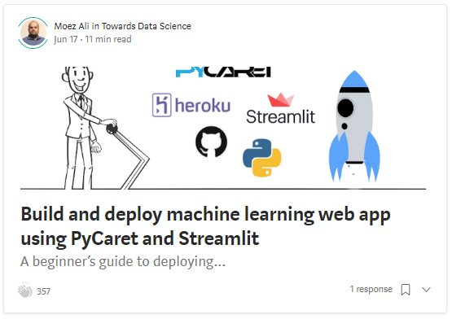
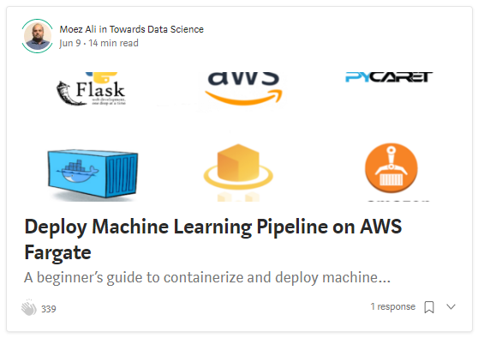
Resources
https://towardsdatascience.com/build-and-deploy-machine-learning-web-app-using-pycaret-and-streamlit-28883a569104
https://towardsdatascience.com/deploy-machine-learning-pipeline-on-aws-fargate-eb6e1c50507

Slide 5
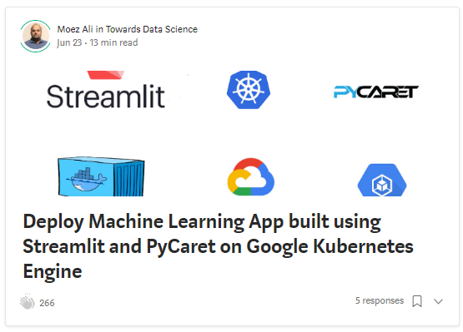
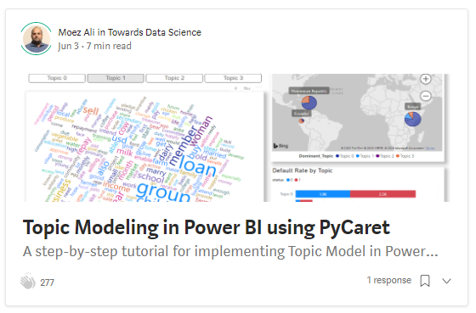
Resources (cont.)
https://towardsdatascience.com/deploy-machine-learning-app-built-using-streamlit-and-pycaret-on-google-kubernetes-engine-fd7e393d99cb
https://towardsdatascience.com/topic-modeling-in-power-bi-using-pycaret-54422b4e36d6

Slide 6
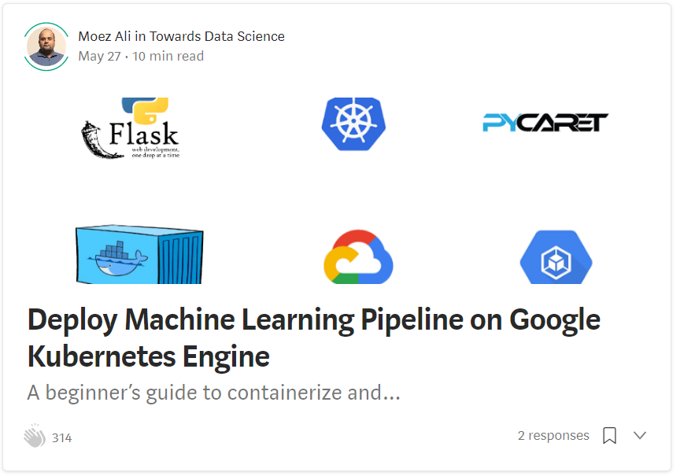
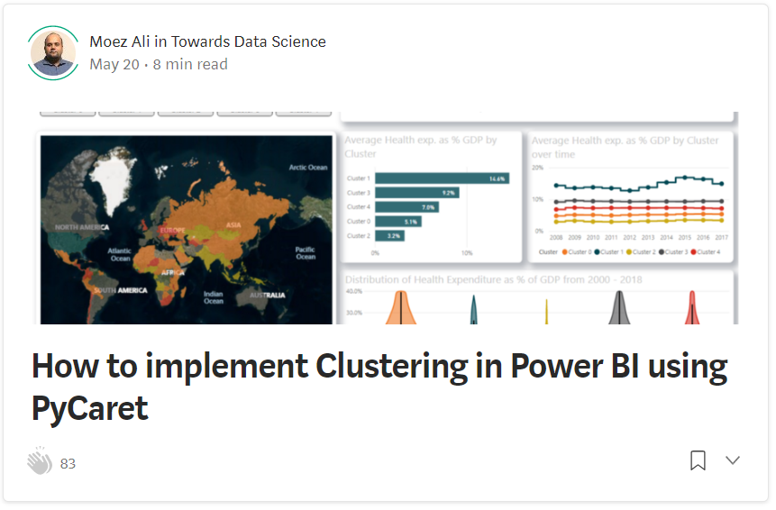
Resources (cont.)
https://towardsdatascience.com/deploy-machine-learning-model-on-google-kubernetes-engine-94daac85108b
https://towardsdatascience.com/how-to-implement-clustering-in-power-bi-using-pycaret-4b5e34b1405b

Slide 7
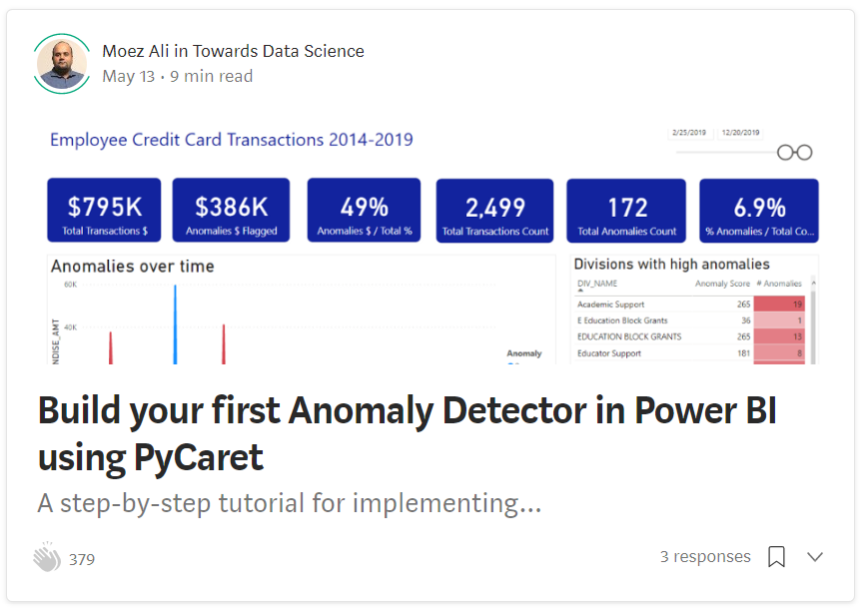
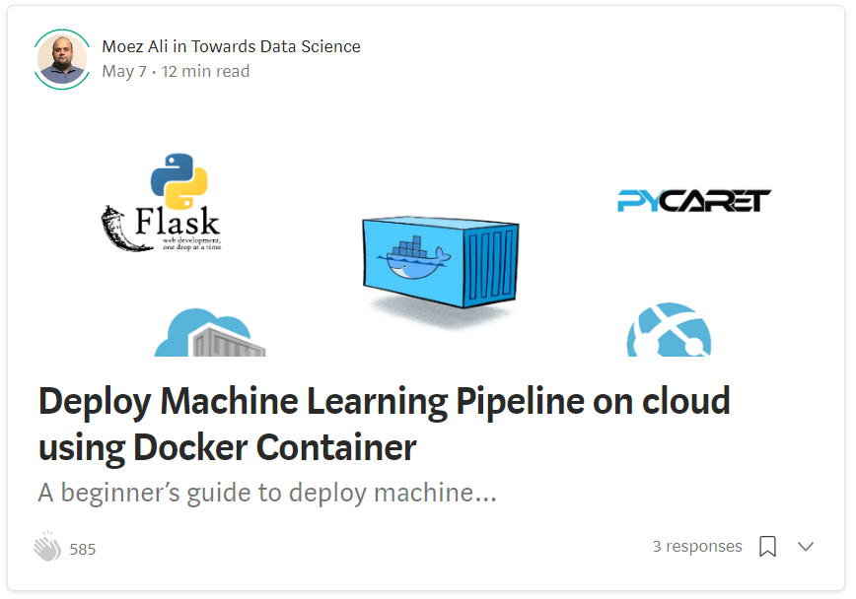
Resources (cont.)
https://towardsdatascience.com/build-your-first-anomaly-detector-in-power-bi-using-pycaret-2b41b363244e
https://towardsdatascience.com/deploy-machine-learning-pipeline-on-cloud-using-docker-container-bec64458dc01

Slide 8
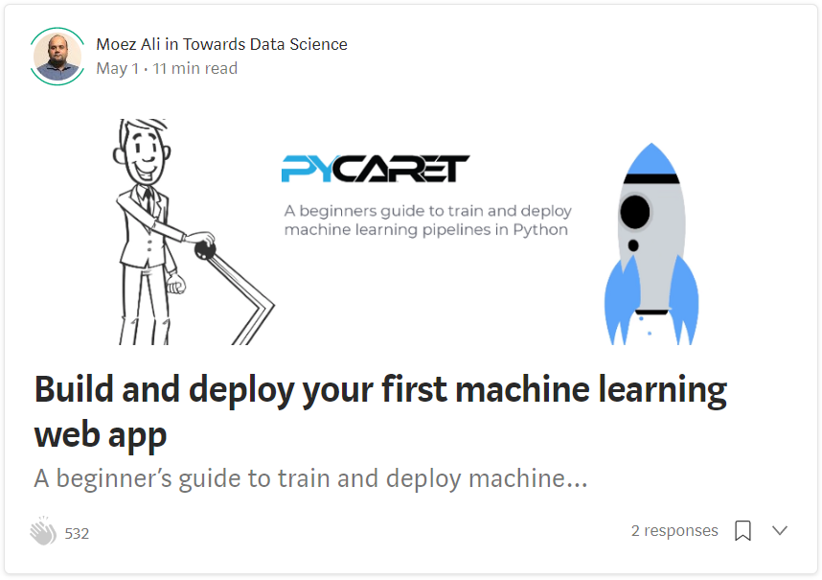
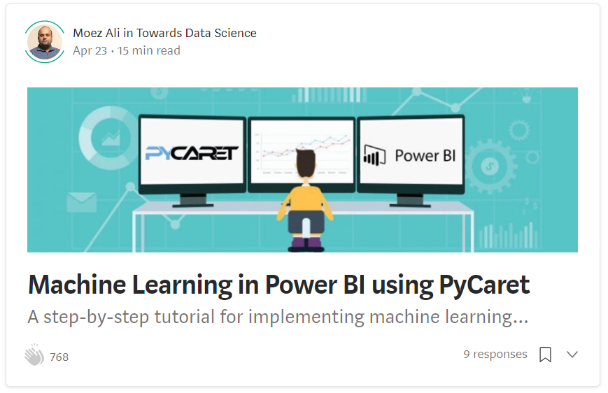
Resources (cont.)
https://towardsdatascience.com/build-and-deploy-your-first-machine-learning-web-app-e020db344a99
https://towardsdatascience.com/machine-learning-in-power-bi-using-pycaret-34307f09394a

Slide 9
Resources (cont.) – Official Video Tutorials
Binary Classification Video Tutorial
https://www.youtube.com/watch?v=2xAgLKUN6Xs
Clustering in PyCaret Video Tutorial
https://www.youtube.com/watch?v=2oxLDir7foQ
Anomaly Detection in PyCaret Video Tutorial
https://www.youtube.com/watch?v=q0dxYDq1A40&t=2s
Topic Modeling in PyCaret Video Tutorial
https://www.youtube.com/watch?v=G6ShuoM3T1M
Association Rule Mining in PyCaret Video Tutorial
https://www.youtube.com/watch?v=XYAGwts5qGw

Slide 10
Resources (cont.)
Machine Learning in SQL by Umar Farooque
https://towardsdatascience.com/machine-learning-in-sql-using-pycaret-87aff377d90c
PyCaret’s integration with Tableau by Andrew Cowan-Nagora
https://towardsdatascience.com/machine-learning-in-tableau-with-pycaret-166ffac9b22e
NLP Classification using PyCaret by Prateek Baghel
https://towardsdatascience.com/predicting-crashes-in-gold-prices-using-machine-learning-5769f548496
Predict Gold Price Returns using PyCaret by Riazuddin Mohammad
https://towardsdatascience.com/machine-learning-to-predict-gold-price-returns-4bdb0506b132
Predict Crashes in Gold Price using PyCaret by Riazuddin Mohammad
https://towardsdatascience.com/predicting-crashes-in-gold-prices-using-machine-learning-5769f548496

Slide 11
Resources (cont.)
Binary Classification Notebook by Murali Tedla
https://colab.research.google.com/drive/1W6ZYw5oAN7V85utFkXkCQq3iBWjqP1WB
Wine Quality Prediction by Abhinav Arora
https://colab.research.google.com/drive/1uFNmhgM9ghVrtqN3MXaofxDlLePb3yIi#scrollTo=sYsHyY8uH6tb
Build your machine learning models by Lakshay Arora
https://www.analyticsvidhya.com/blog/2020/05/pycaret-machine-learning-model-seconds/
PyCaret’s Integration with Power BI (1 Hour Video Tutorial)
https://www.youtube.com/watch?v=ZeQVkEWo2x0
Anomaly Detection using PyCaret by Krish Naik (Video Tutorial)
https://www.youtube.com/watch?v=ZeQVkEWo2x0

Slide 12
Agenda
What is PyCaret?
New Features in PyCaret 2.0x
Demo using PyCaret 1.0x
What is deployment and why deploy machine learning models?
What is a container? What is Docker?
Deployment Demo 1 – Heroku
Deployment Demo 2 – AWS Fargate (Time permit)
Q&A

Slide 13
Let’s get started
If you plan to follow along the demo part. You can clone the following GitHub repository:
https://www.github.com/pycaret/pycaret-demo-sif
Alternatively, you can run the notebooks on Google Colab. Follow the link below:
https://pycaret.org/demo/
To install pycaret on your local machine type “pip install pycaret” in Jupyter Notebook or Anaconda Prompt. Installation will take 5-10 minutes.

Slide 14

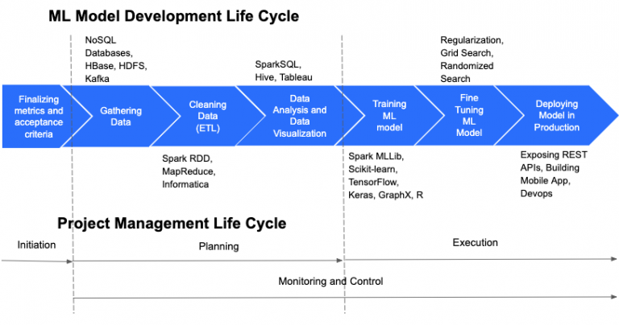
https://cloudxlab.com/blog/things-to-consider-while-managing-machine-learning-projects/machine-learning-and-project-management-life-cycle-2/

Slide 15
Granular ML Life Cycle of a supervised experiment
Business Problem
Define ML Objective
Collect Data
Analyze
Train Test Split
Handle Datatypes
Impute Missing Values
… zillion other things
Feature Selection
Feature Interaction
Feature Engineering
Transformations
Scaling
Encodings
REPEAT
Model Training
Cross Validation
Track Performance
Hyperparameter tuning
Track Performance
Ensemble Model
Track Performance
Deploy Model
… zillion other things
Analyze Plots
Track Performance
Stack Models
Track Performance
Blend Models

Slide 16
What’s the challenge?
Machine Learning is an iterative process.
It’s about asking the right questions and in order to get to right questions it’s important to remain focused.
Creating a seamless pipeline is hard. Managing it is harder.
Current tools are not business-friendly. Domain expertise play big role in ML experiments, however they are not empowered.

Slide 17



What is PyCaret?
PyCaret is an open source, low-code machine learning library in Python that aims to reduce the cycle time from hypothesis to insights. PyCaret can be used for rapidly developing and deploying machine learning pipeline.
EASY TO USE
PRODUCTIVITY TOOL
BUSINESS READY

Slide 18
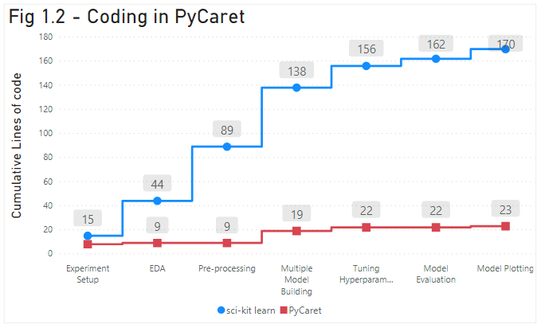
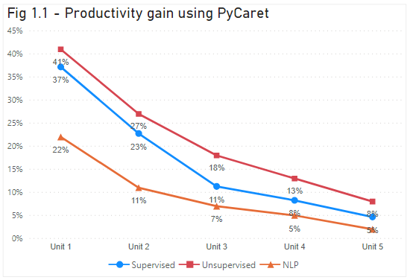
Effect of using PyCaret

Slide 19
Facts
Started in summer of 2019
Written in Python. Future versions may include wrappers in other langs.
Project took approximately 1 year to complete.
Self-funded so far.
Supported by team of brilliant people. To contribute please visit https://www.pycaret.org/contribute

Slide 20
New Features in PyCaret 2.0x
Modular Automation
Behavior of compare_models
Behavior of tune_models
Customize parameters
NEW FUNCTION: automl
MLFlow logging back-end
NEW PARAMETER: log_experiment
NEW FUNCTION: get_logs
System logs automatically created
Command Line Support
Support outside Notebook environment
Execute as python scripts
Remote execution (for e.g. Kaggle Kernels)
Preprocessing
NEW PARAMETERS:
fix_imbalance
data_split_shuffle
folds_shuffle
remove_perfect_collinearity
Utility functions
pull function
models
get_logs
get_config
set_config

Slide 21
PyCaret 2.0x Feature Demo
Moez Ali live on Friday, July 17 9:30 PM IST. Live questions allowed. Google calendar link: https://bit.ly/2OiVlZN YouTube LIVE: https://lnkd.in/dbQ3Qav

Slide 22


Demo PyCaret 1.0x
Clone repository from https://github.com/pycaret/pycaret-demo-sif
Install PyCaret by running "pip install pycaret" in Notebook or in Anaconda prompt
If you are using MAC OS, you might have to install LightGBM separately. Follow instructions on this link: https://www.pycaret.org/install
Links to demo notebook at https://www.pycaret.org/demo
You can also execute the notebook in playground mode by installing pycaret on colab by using "!pip install pycaret".
You must have a google account to use Google colab.

Slide 23
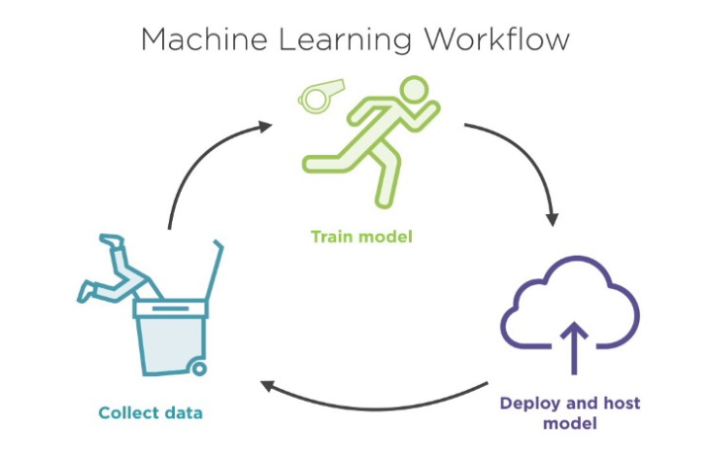
What is deployment?
The deployment of machine learning models is the process of making models available in production where web applications, enterprise software and APIs can consume the trained model by providing new data points and generating predictions.

Slide 24

What is a container?
The most intuitive way to understand containers is to think them as containers on a ship where the goal is to isolate the contents of one container from the others so they don’t get mixed up. This is exactly what containers are used for in data science.

Slide 25
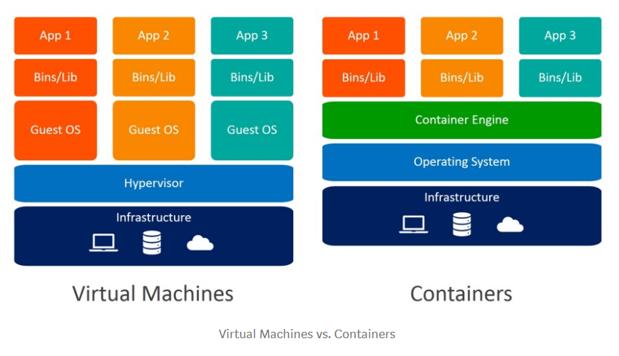
Why not just use virtual machines?

Slide 26

What is Docker?
Docker is a company that provides software (also called Docker) that allows users to build, run and manage containers. While Docker’s container are the most common, there are other less famous alternatives such as LXD and LXC that provides container solution.

Slide 27
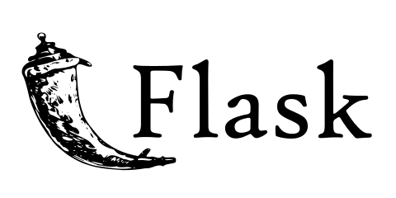
Flask
Flask is a web framework. This means flask provides you with tools, libraries and technologies that allow you to build a web application. This web application can be some web pages, a blog, a wiki or go as big as a web-based calendar application or a commercial website.

Slide 28

Streamlit
Streamlit’s open-source app framework is the easiest way for data scientists and machine learning engineers to create beautiful, performant apps in only a few hours! All in pure Python. All for free.

Slide 29

Demo 1 – Deploy Flask app on Heroku
Clone repository https://github.com/pycaret/deployment-heroku
Heroku is a cloud platform as a service supporting several programming languages. One of the first cloud platforms, Heroku has been in development since June 2007, when it supported only the Ruby programming language, but now supports Java, Node.js, Scala, Clojure, Python, PHP, and Go.

Slide 30
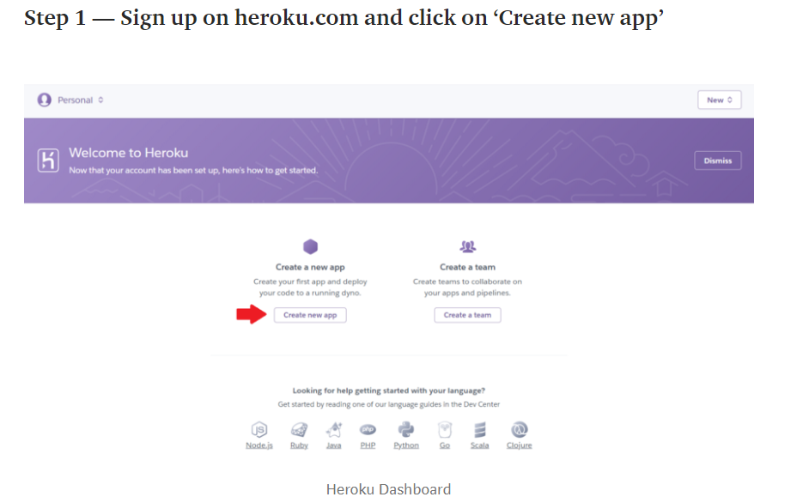

Slide 31
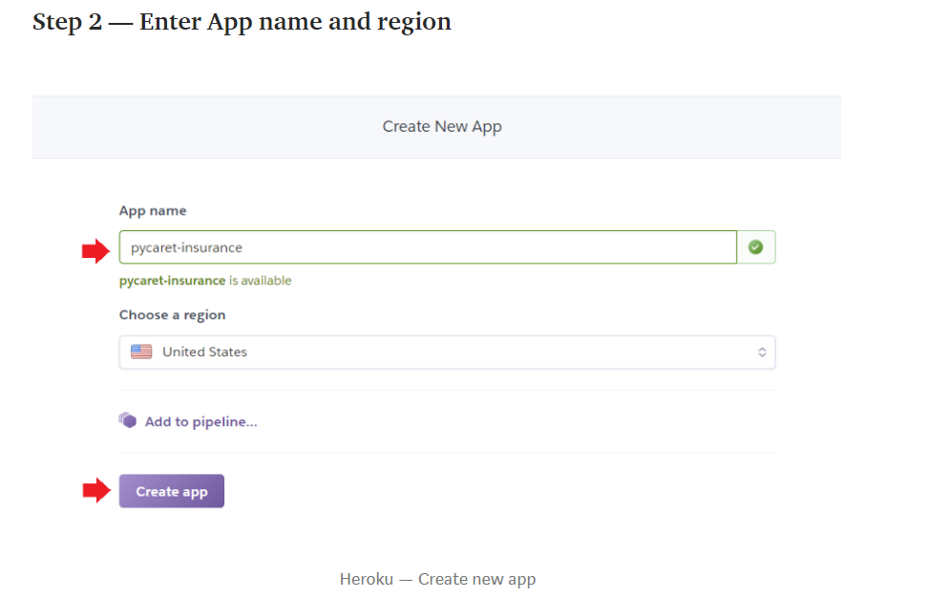

Slide 32
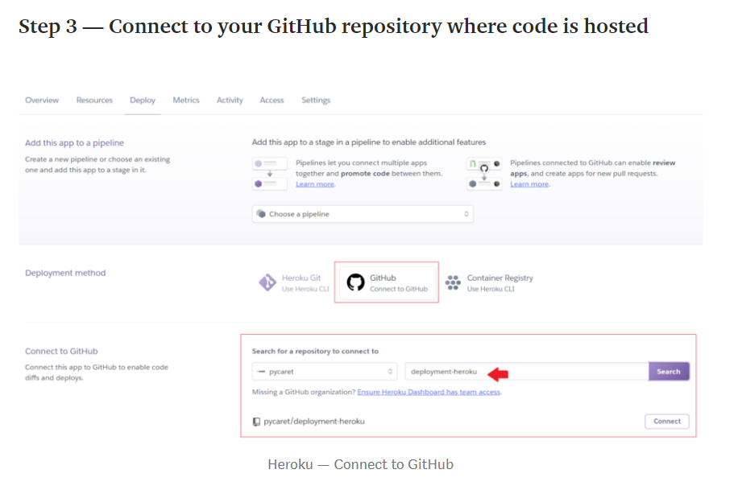

Slide 33
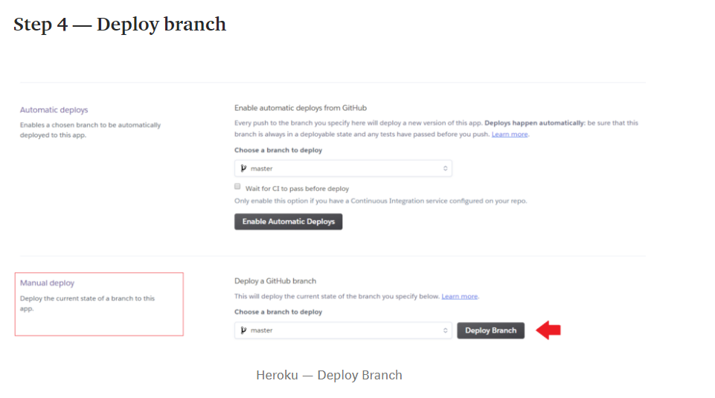

Slide 34
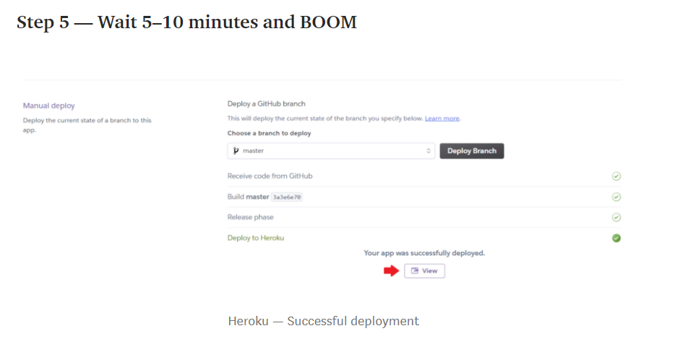

Slide 35
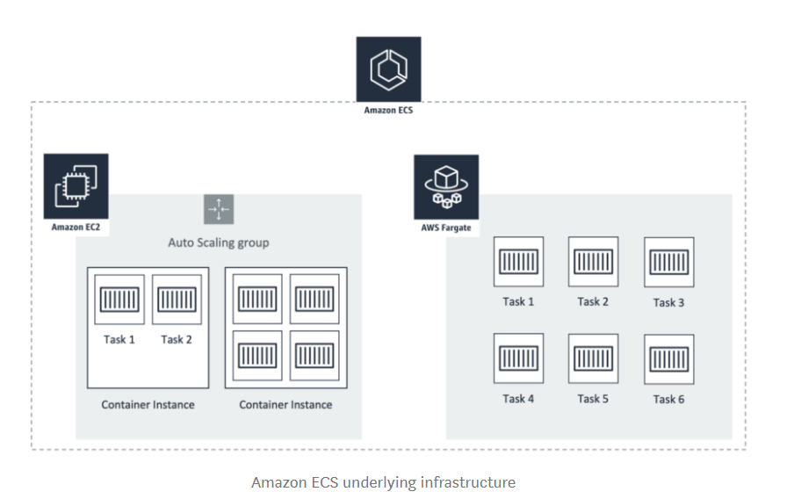
Demo 2 – Deploy Streamlit app on AWS Fargate
Clone repository https://github.com/pycaret/pycaret-streamlit-aws
AWS Fargate is a serverless compute engine for containers that works with both Amazon Elastic Container Service (ECS) and Amazon Elastic Kubernetes Service (EKS).

Slide 36
Thank you
Questions?

